Slide 1
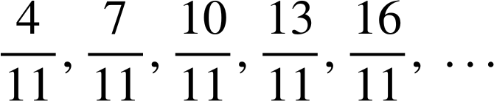
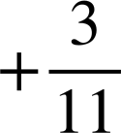
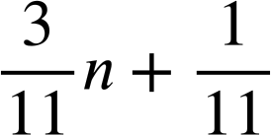
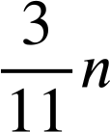
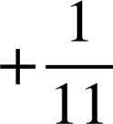
Securing understanding of arithmetic sequences
Task A: Reviewing the n^{th} term
1) Find the n^{th} term of these sequences.
a) 11, 19, 27, 35, 43, …
Common difference: +8
Translation from 8n: +3
8n + 3
b) 4, 12, 20, 28, 36, …
Common difference: +8
Translation from 8n: −4
8n − 4
c) 11, 7, 3, −1, −5, …
Common difference: −4
Translation from −4n: +15
−4n + 15
or…
15 − 4n
d) 1.1, 1.9, 2.7, 3.5, 4.3, …
Common difference: +0.8
Translation from 0.8n: +0.3
0.8n + 0.3
e)
Common difference:
Translation from :
Task B: Using the n^{th} term
1) For each sequence:
(i) find the n^{th} term,
(ii) find the 100th term,
(iii) identify if 500 is in the sequence and if so, its position.
a) −10, −7, −4, −1, 3, …
(i) n^{th} term: 3n − 13
(ii) 100th term: 3(100) − 13 = 287
3n − 13 | = | 500
3n | = | 513
n | = | 171
(iii)
b) 999, 996, 993, 990, 987, …
500 is the 171st term.
(i) n^{th} term: 1002 − 3n
(ii) 100th term: 1002 − 3(100) = 702
(iii)
1002 − 3n | = | 500
502 | = | 3n
n | = | 167.3 (to 1d.p.)
c) 8.4, 8.8, 9.2, 9.6, …
500 is not a term in the sequence.
(i) n^{th} term: 0.4n + 8
(ii) 100th term: 0.4(100) + 8 = 48
0.4n + 8 | = | 500
0.4n | = | 492
n | = | 1230
(iii)
500 is the 1230th term.

Slide 2
Securing understanding of arithmetic sequences
c) 8.4, 8.8, 9.2, 9.6, …
(i) n^{th} term: 0.4n + 8
(ii) 100th term: 0.4(100) + 8 = 48
0.4n + 8 | = | 500
0.4n | = | 492
n | = | 1230
(iii)
500 is the 1230th term.
2) Assuming each pattern continues to grow the same way, will we see one with exactly 250 circles?
5, 8, 11, …
3n + 2
3n + 2 | = | 250
3n | = | 248
n | = | 82.6
a)
.
,
,
, …
No
8, 10, 12, …
2n + 6
2n + 6 | = | 250
2n | = | 244
n | = | 122
b)
,
,
, …
Yes
(All evens ≥8)
4n + 6 | = | 250
4n | = | 244
n | = | 61
c)
10, 14, 18, …
4n + 6
,
,
, …
Yes
Task C: Generalising finding the n^{th} term
1) Write the first five terms of these sequences:
a) 5 + 4(n − 1)
a = 5, d = 4
5, 9, 13, 17, 21, …
b) 4 + 5(n − 1)
a = 4, d = 5
4, 9, 14, 19, 24, …
c) 4 − 5(n − 1)
a = 4, d = −5
4, −1, −6, −11, −16, …
Hint: They are written in the form a + d(n − 1) where a is the first term and d is the common difference.

Slide 3
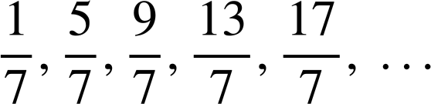
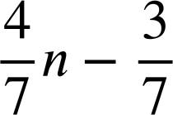
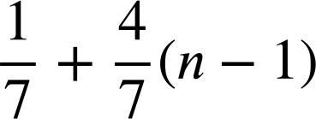
Securing understanding of arithmetic sequences
2) Write two different generalisations for each of these arithmetic sequences:
a) 7, 10, 13, 16, 19, …
b) 7, −3, −13, −23, −33, …
3n + 4
17 − 10n
7 + 3(n − 1)
7 − 10(n − 1)
c) 0.7, 0.95, 1.2, 1.45, 1.7, …
d)
0.25n + 0.45
0.7 + 0.25(n − 1)
3) For the sequence 24 + 7(n − 1)
a) Find the first five terms.
24, 31, 38, 45, 52, …
b) Find the 100th term.
24 + 7(100 − 1) = 24 + 7(99) = 717
c) Find the position of the term 388 in the sequence.
24 + 7(n − 1) | = | 388
7(n − 1) | = | 364
n − 1 | = | 52
n | = | 53
Mathematics in Education and Industry.
v2.3

